Slide 1


INTRODUCTION
S S GOH
VOLUNTEER INSTRUCTOR
PI PYTHON COMMUNITY
LEARNX COMMUNITY – TAMPINES REGIONAL LIBRARY (NLB)
https://learning.nlb.gov.sg/communities/join/digital-communities
“Let’s make our learning communities a warm, welcoming and safe space.”

Slide 2

A PRACTICAL APPROACH TO TEACH PYTHON PROGRAMMING

Slide 3
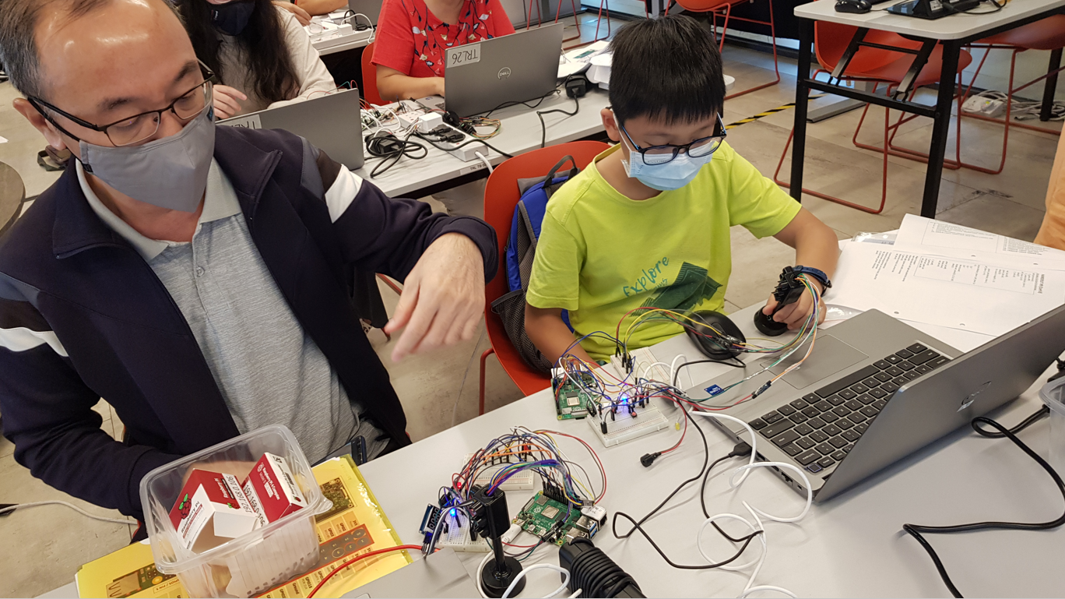
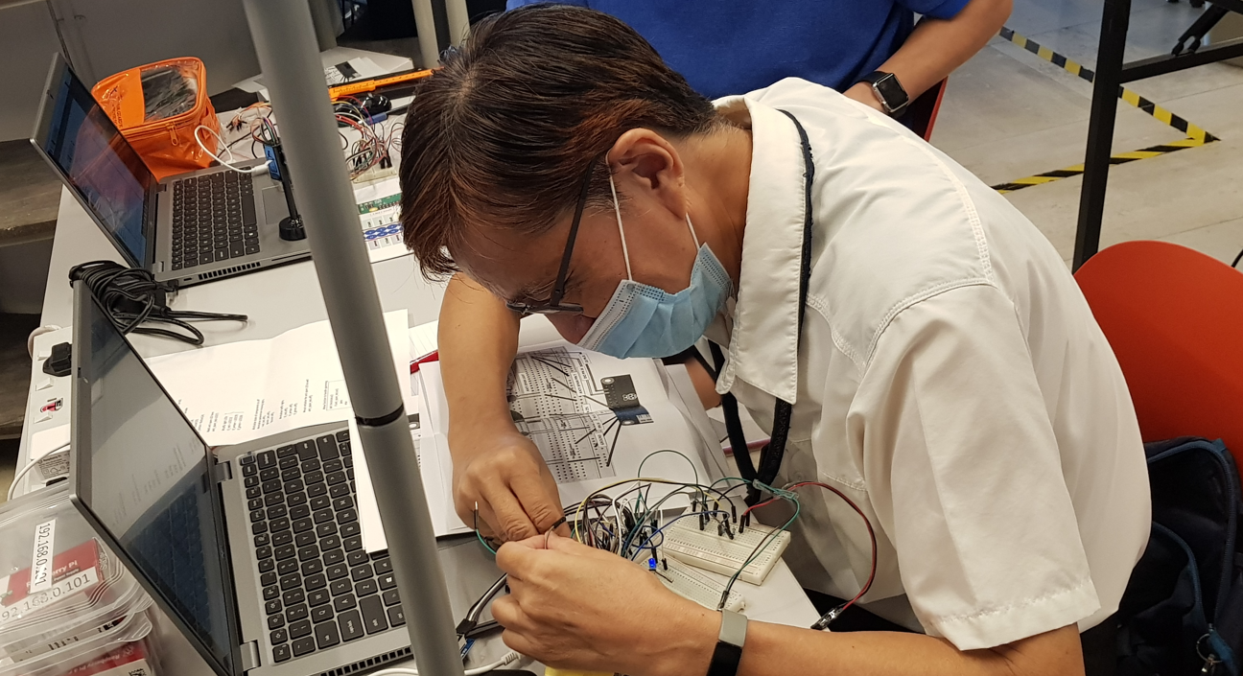
LEARNX COMMUNITY
PROFILE OF OUR PARTICIPANTS
NEWBIES / NOOBS
CONVENTIONAL WAY WOULD BE DRY AND BORING
TIME CONSUMING
TECHNICAL JARGON WILL KILL INTEREST (DOA)
NOOB/NEWBIE FRIENDLY
CAPTIVATE INTEREST FIRST
EASY TO UNDERSTAND
NO JARGON
RESULTS WITH FEW LINES OF CODES
ENGAGING - PARTICIPATIVE
ENTERTAINING
INTERESTING
THE RASPBERRY PI MEETS OUR CRITERIA

Slide 4
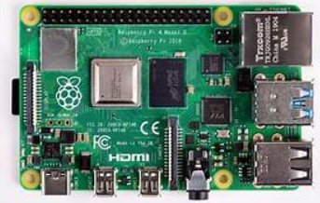
TOUTED AS THE WORLD’S SMALLEST COMPUTER, THE SIZE OF A CREDIT CARD
THE BRAINCHILD OF PROF EBEN UPTON OF CAMBRIDGE UNIVERSITY
AN INEXPENSIVE WAY TO PROMOTE LEARNING, TINKERING AND EXPERIMENTATION IN COMPUTING
USED EXTENSIVELY FOR STEM EDUCATION IN EUROPE / US
THE OS COMES PRE-INSTALLED WITH PYTHON AND ALL THE LIBRARIES THAT ARE NEEDED TO KICK START THE LEARNING PROCESS

Slide 5
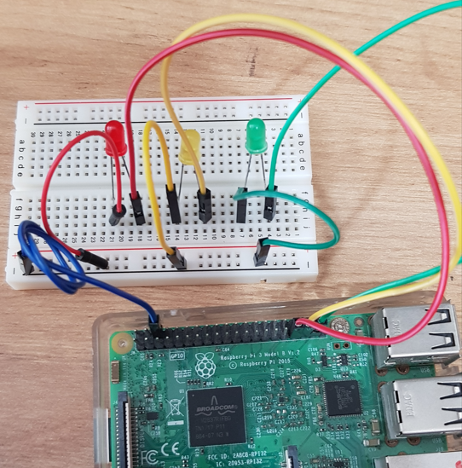
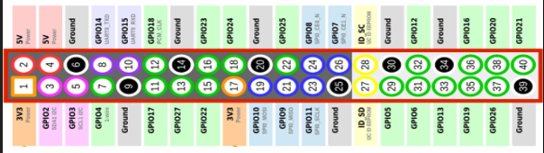
Unlike a regular computer, the Pi has 40 GPIO pins to which we can attach sensors, LEDs, buzzers, motors, relays
These devices, once attached can be controlled using Python codes using the Libraries that comes with the PI
This is the practical, participative and engaging aspect of it

Slide 6
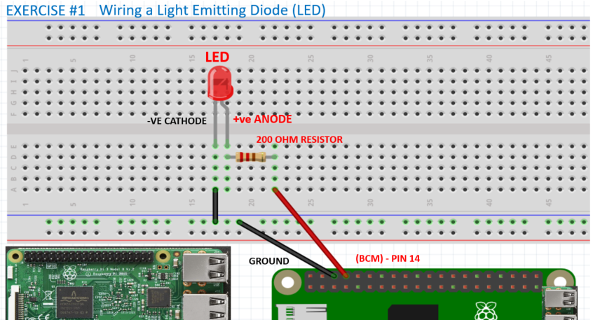
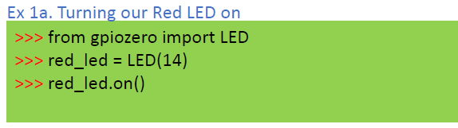
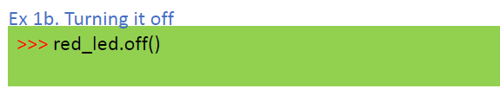
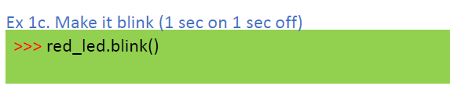
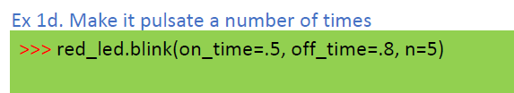

Slide 7
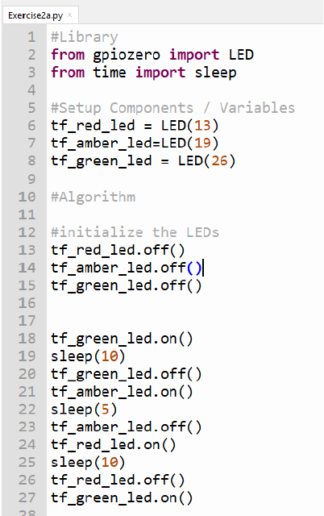
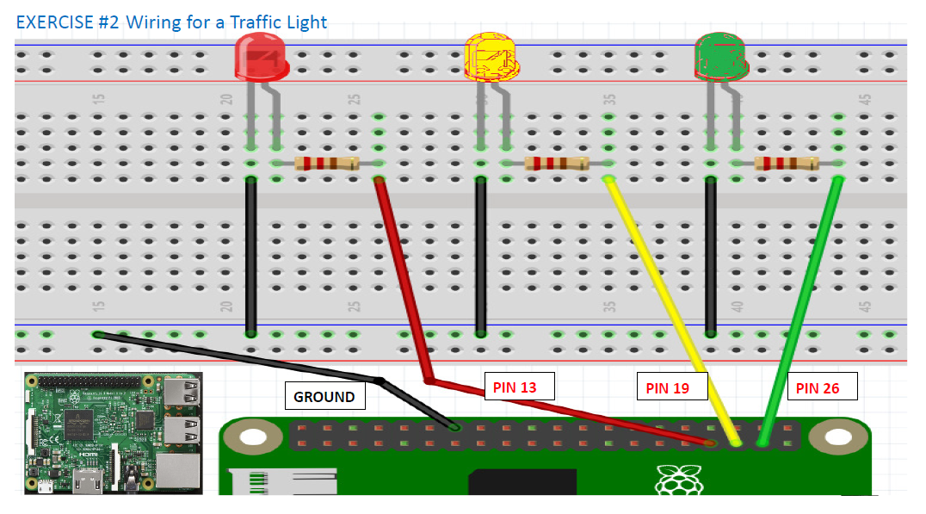
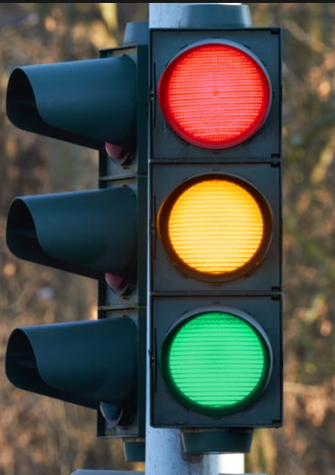
ALGORITHM FOR A TRAFFIC LIGHT SYSTEM
STARTS WITH GREEN
AFTER 10 SECONDS
GREEN GOES OFF
YELLOW COMES ON
AFTER 5 SECONDS
YELLOW GOES OFF
RED COMES ON
AFTER 10 SECONDS
GREEN COMES ON
>>> from gpiozero import LED
>>> tf_red_led = LED(13)
>>> tf_yellow_led = LED(19)
>>> tf_green_led = LED(26)
Notes:
Add 2 more coloured LEDs
Suggest an application with new found knowledge
Obviously – Traffic Light comes to mind
What do we need for a traffic light – Sequencing
Write the desired sequence for the traffic light
Translate it to code
Run and Debug

Slide 8
RUN / DEBUG
COMMON TYPES OF ERRORS
SYNTAX ERRORS
INDENTATION ERROR
LOGICAL ERRORS
CIRCUITRY ERRORS
Notes:
Confidence boosting if all goes well
So far we have been using very simple codes to drive our application
From here we will up the ante and introduce more complicated circuits
But still employing most of the same codes they learned earlier

Slide 9
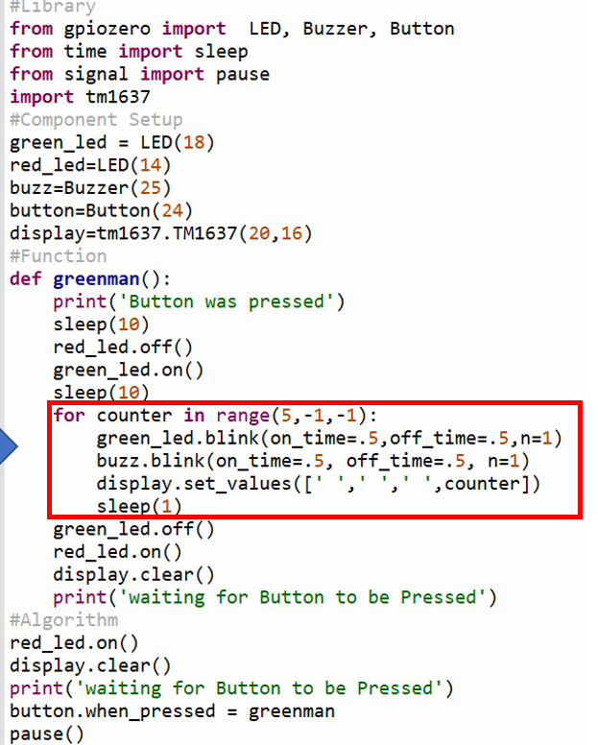
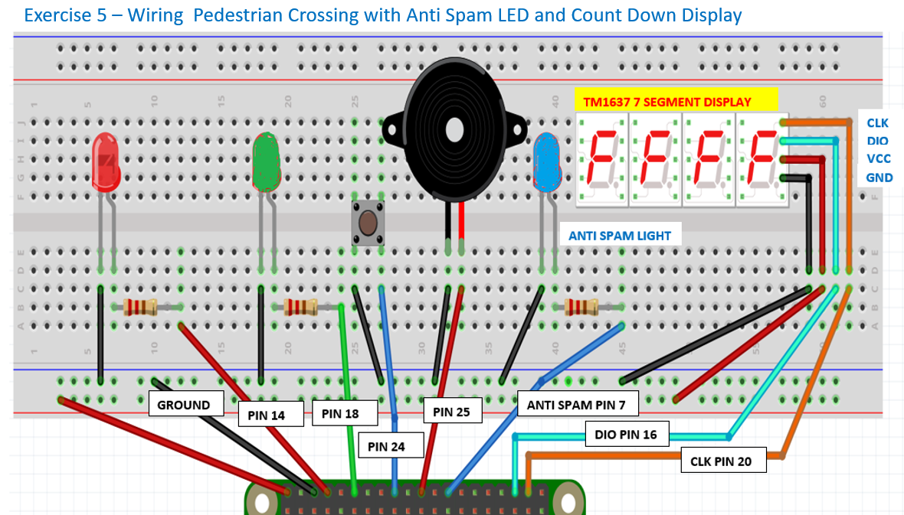
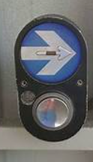
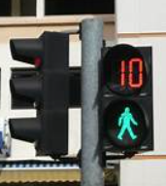
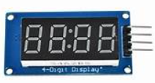
ADVANCED APPLICATIONS
A VISIBLE FOR LOOP EXAMPLE
Notes:
This is the wiring for a pedestrian crossing
Interactions between the real world, humans and the computer program
The button – is a request (in this case please help me to safely cross this road)
The blinking green light, buzzer and counter – messages sent to human
This can be achieved with just a few lines of codes which they have learned earlier
Visually demonstrate how a Python For Loop works

Slide 10
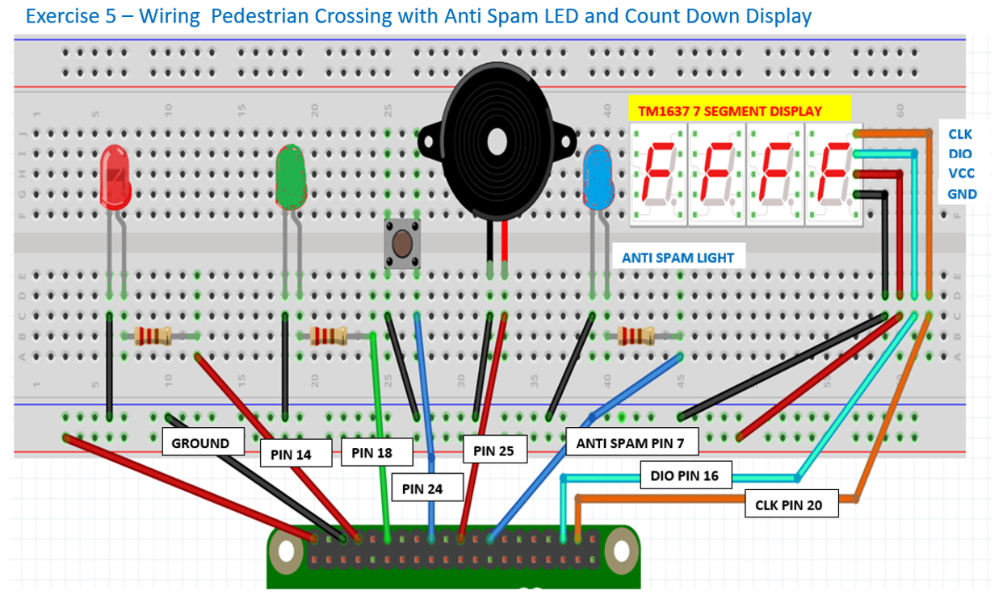
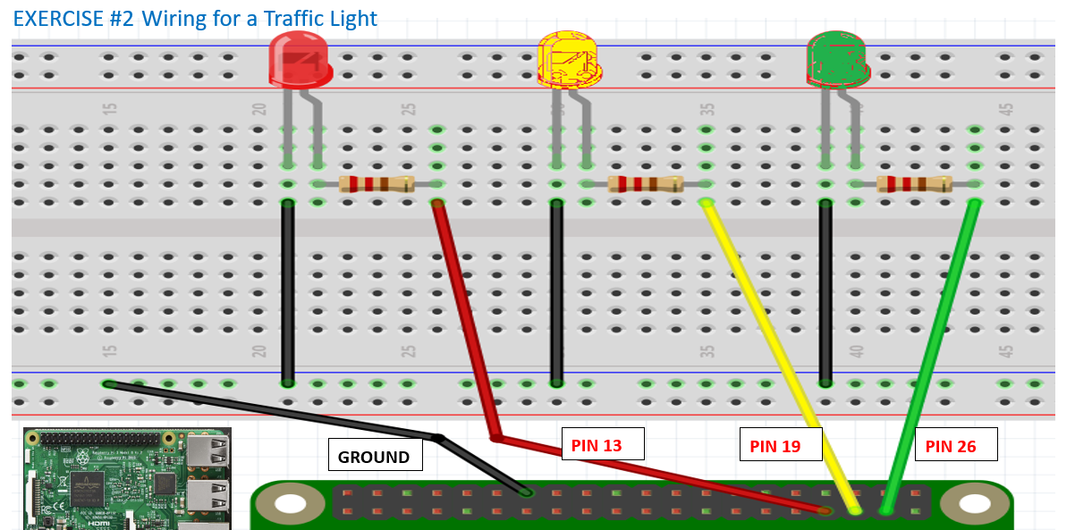
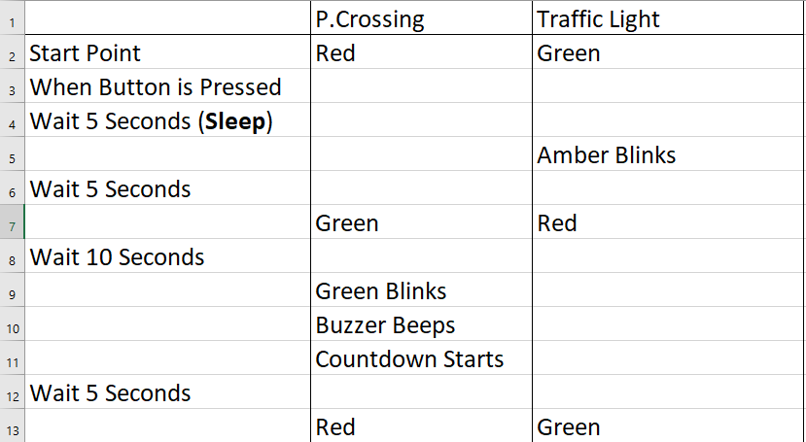
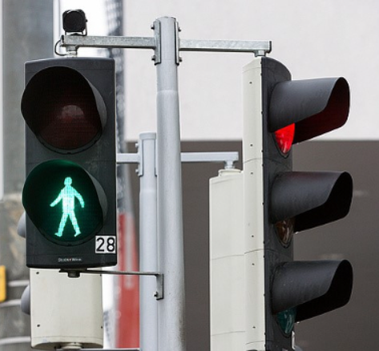
HOW SYSTEMS WORK TOGETHER
Notes:
These two systems has got to work together
Directing humans and vehicular traffic

Slide 11
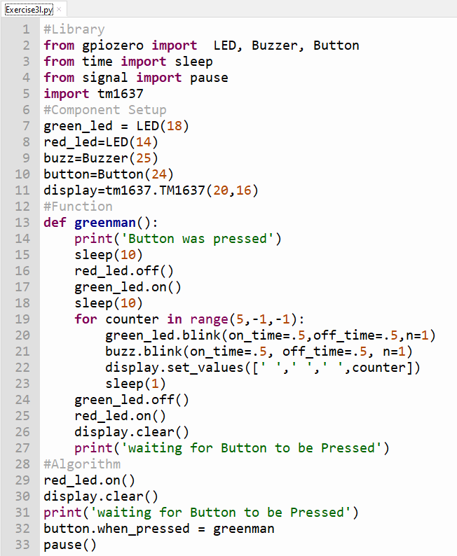
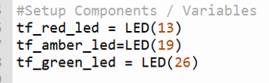
Suggestion for how this can be done
We take the code from Exercise3l.py
Modify the codes to match the Algorithm

Slide 12
SUMMARY
LIFE BEYOND CURRICULUM
THERE’S NO WAY YOU CAN TEACH SOMEONE EVERYTHING
THE COURSE IS A KICKSTART TO THE LEARNING JOURNEY
PROMOTE SELF-LEARNING
FIND SOMETHING USEFUL TO PURSUE
JOIN PI CLUB COMMUNITY
BE PART OF LEARNX TO TEACH OTHERS

